Slide 1
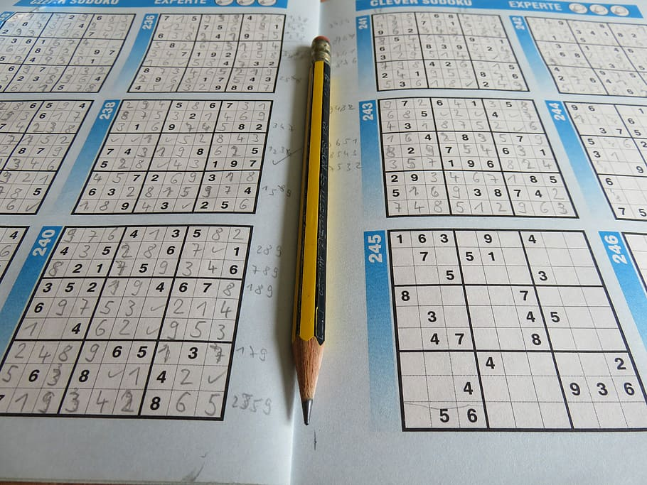
Sudoku

Slide 2
Client requirement
<-Ügyfelünk
-Sudoku webpage

Slide 3
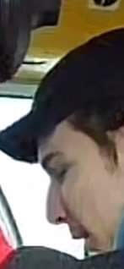
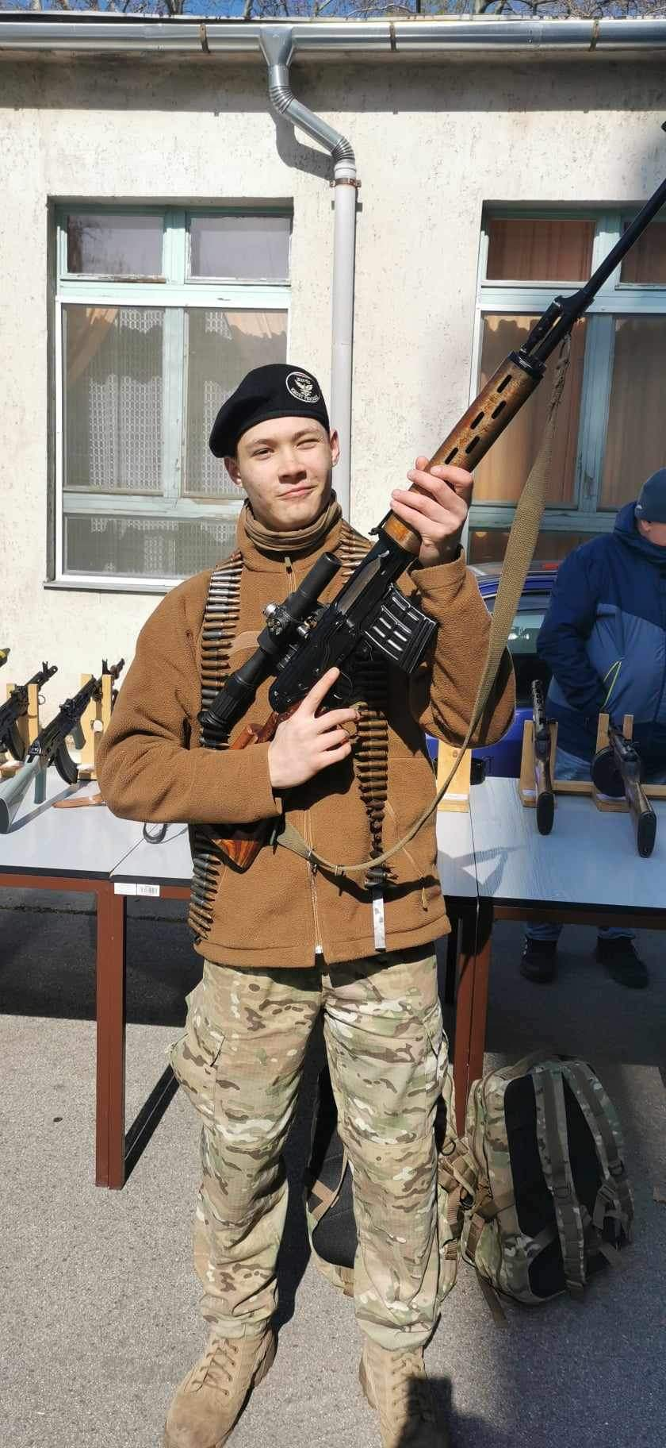
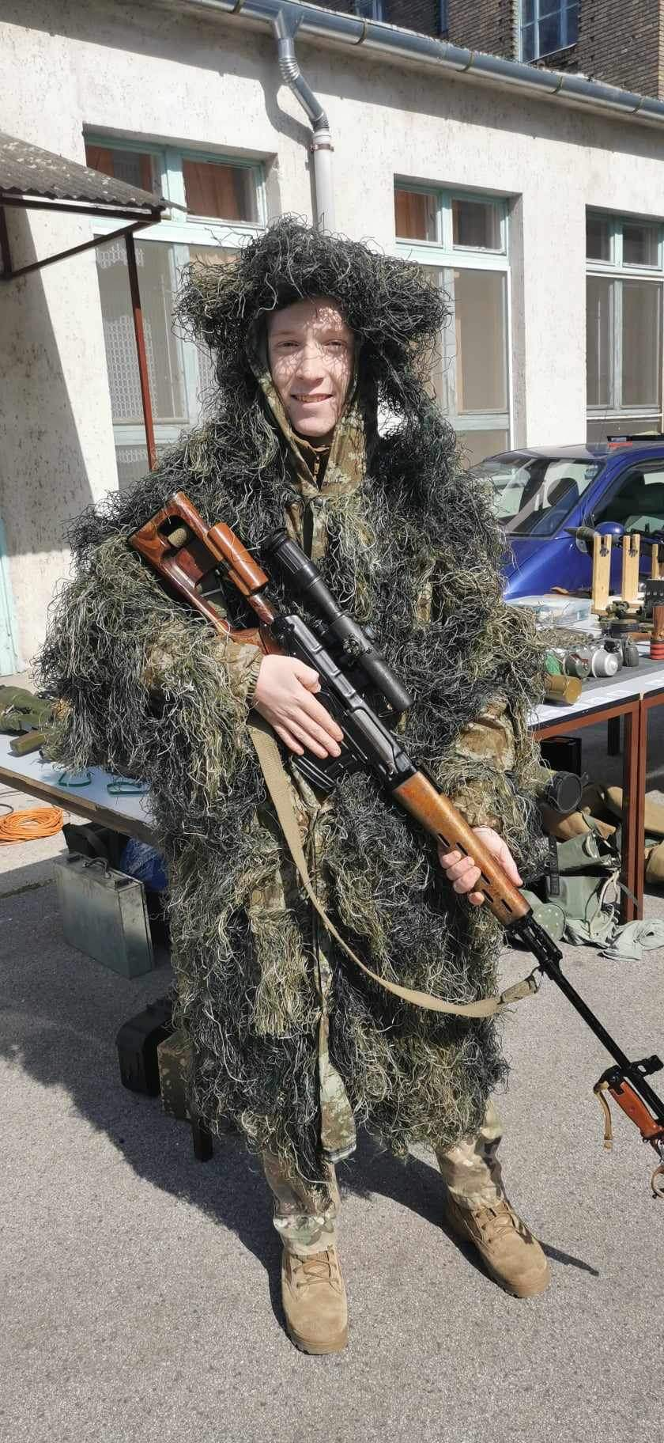
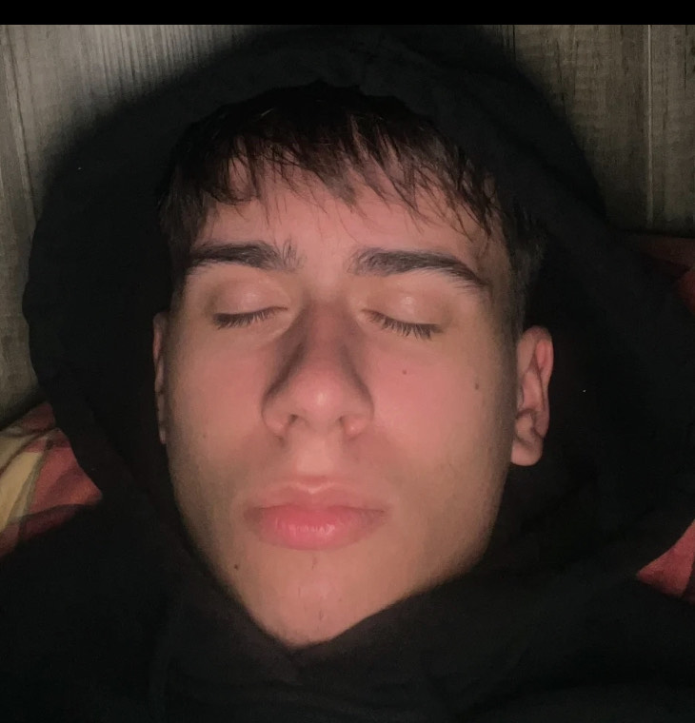
team
Javascript
Modal
Webpage
Presentation
Krisztián
Zsolt
Milán
Tibi

Slide 4
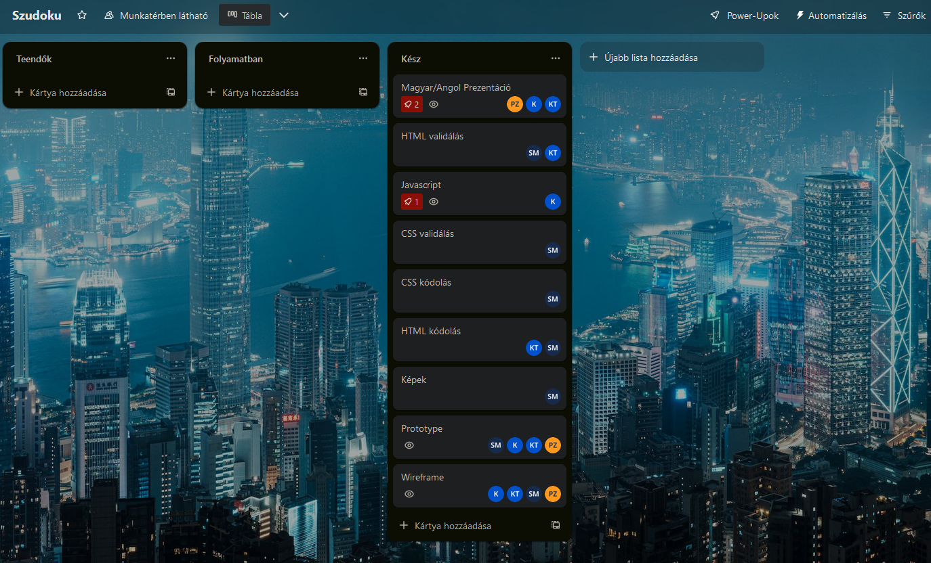
Projekt planning
CSS settings – Krisztián, Zsolt, Milán
Main page – Milán
HTML and CSS validation – Krisztián Modal– Zsolt
Git repository– Milán Prototype - everyone

Slide 5

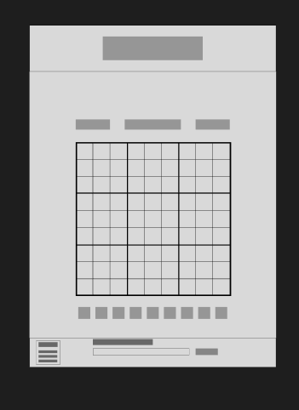
Wireframe

Slide 6
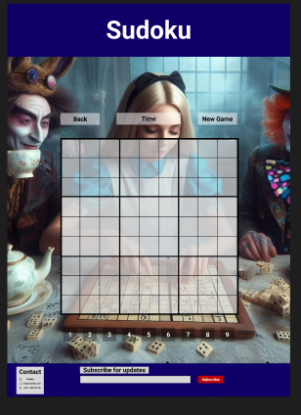
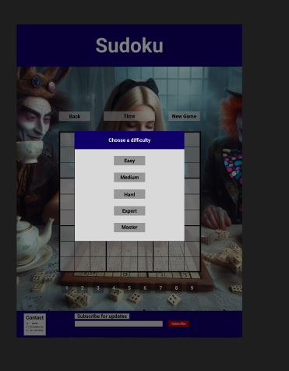
Prototype

Slide 7
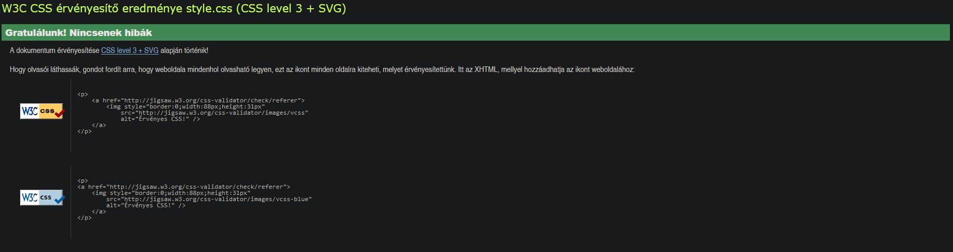
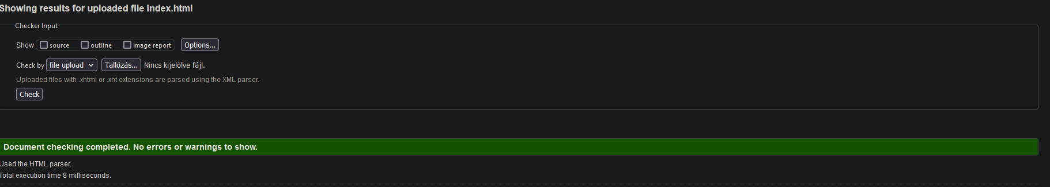
Validation

Slide 8
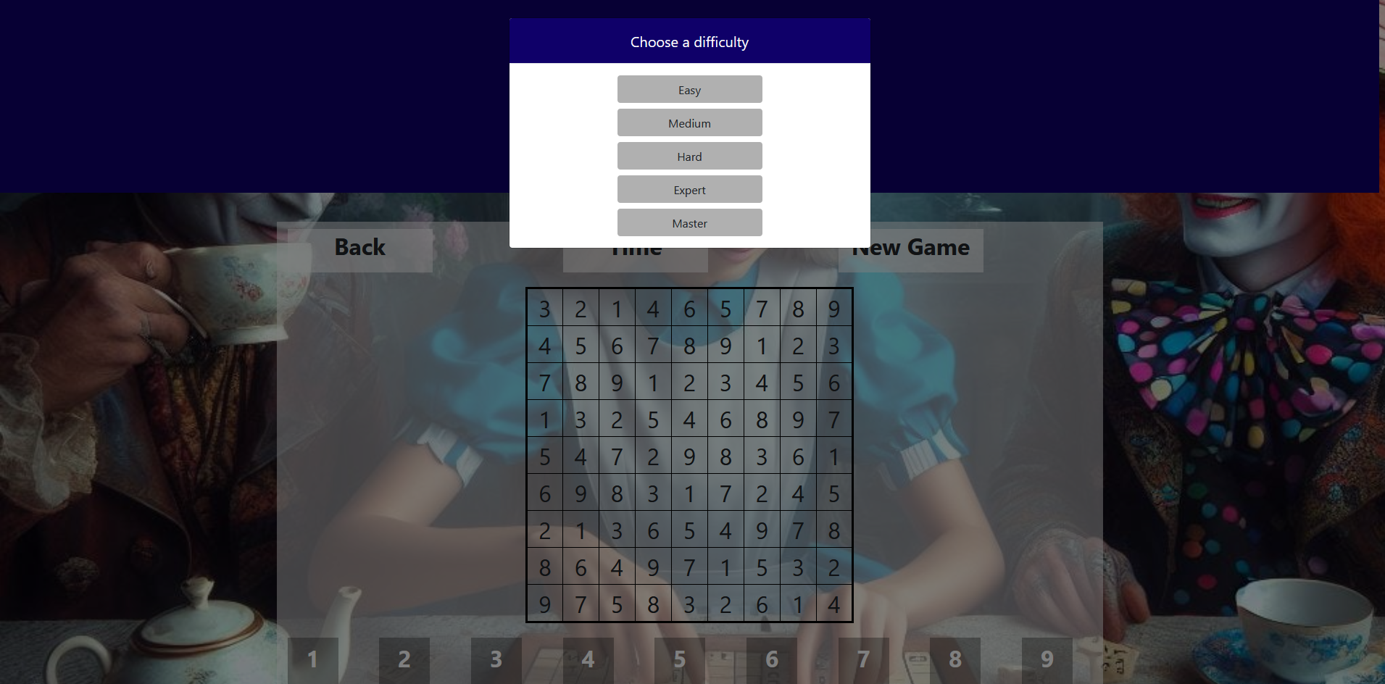
Modal

Slide 9
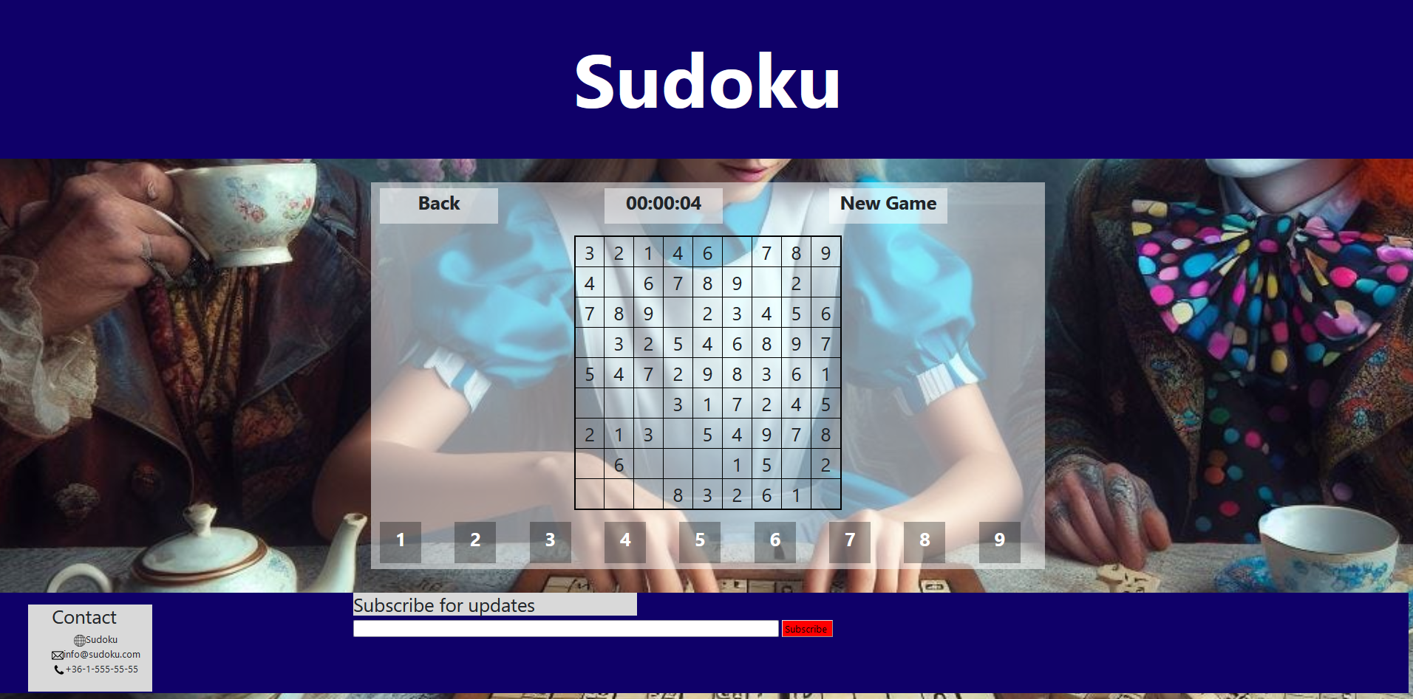
webpage

Slide 10
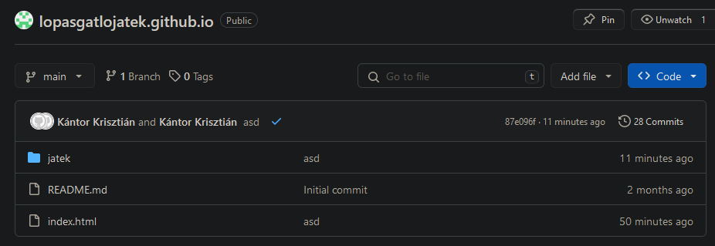
Github

Slide 11
The link
https://tsikkk.github.io/lopasgatlojatek.github.io/

Slide 12
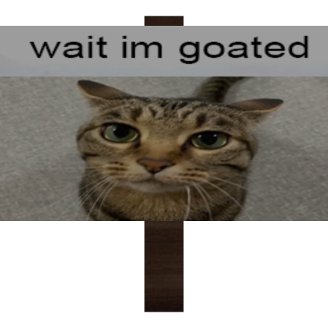
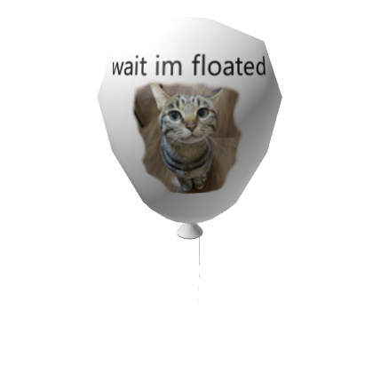
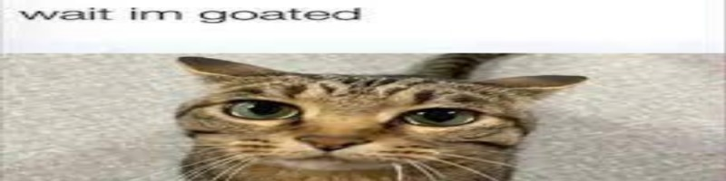

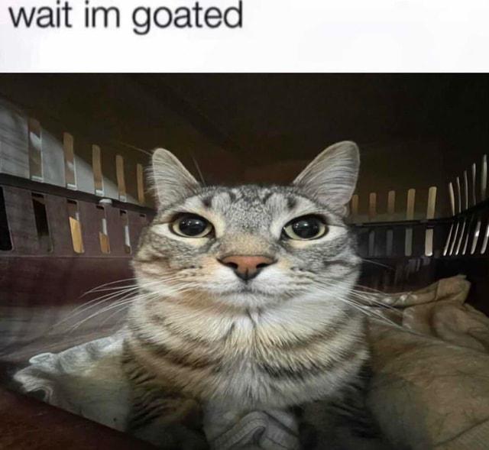
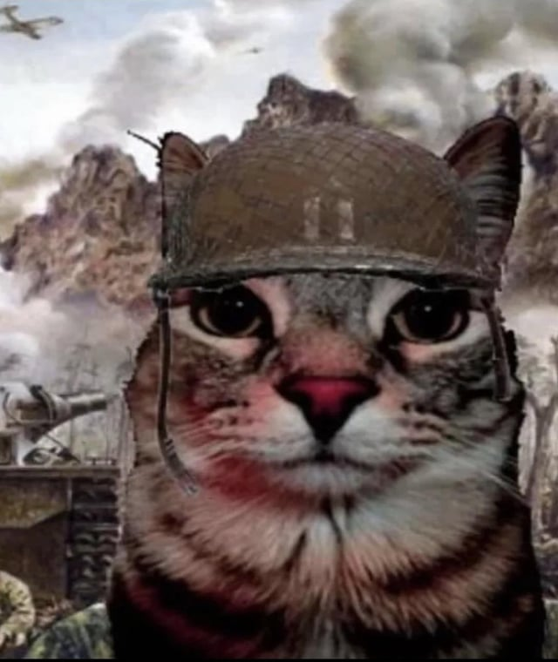
Thanks for your attention

